Slide 1
ENTREPRENEURSHIP
Lecture No: 9
Resource Person:
Malik Jawad Saboor
Assistant Professor
Department of Management Sciences
COMSATS Institute of Information Technology
Islamabad.

Slide 2
Tips for Enhancing Organizational Creativity
Include creativity as a core company value
Embrace diversity
Expect creativity
Expect and tolerate failure
Encourage creativity

Slide 3
Tips for Enhancing Organizational Creativity
Create a change of scenery periodically
View problems as challenges
Provide creativity training
Provide support
Develop a procedure for capturing ideas

Slide 4
Tips for Enhancing Organizational Creativity
Talk with customers
Look for uses for your company’s products or services in other markets
Reward creativity
Model creative behavior

Slide 5
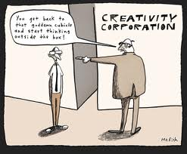

Slide 6

Tips for Enhancing Individual Creativity
Allow yourself to be creative
Give your mind fresh input every day
Observe the products and services of other companies, especially those in completely different markets
Recognize the creative power of mistakes

Slide 7

Tips for Enhancing Individual Creativity
Keep a journal handy to record your thoughts and ideas
Listen to other people
Listen to customers
Talk to a child
Keep a toy box in your office
Read books on stimulating creativity or take a class on creativity
Take some time off

Slide 8

Objectives
To learn creativity techniques
Brainstorming
Mind Mapping
Rapid Prototyping
Mix n Match (Thomas Edison Challenge)
Attribute Listing Chart

Slide 9
Brainstorming
A group problem-solving technique that involves the spontaneous contribution of large quantity of novel and imaginative ideas from all members of the group;
the mulling over of ideas by one or more individuals in an attempt to devise or find a solution to a problem

Slide 10

Brainstorming Guidelines
Keep the group small – “Two pizza rule.”
Make the group as diverse as possible.
Company rank is irrelevant.
Have a well-defined problem, but don’t reveal it ahead of time.
Limit the session to 40 to 60 minutes.
Take a field trip.
Appoint a recorder.

Slide 11
Brainstorming Guidelines
Use a seating pattern that encourages interaction.
Throw logic out the window.
Encourage all ideas from the team.
Shoot for quantity of ideas over quality of ideas.
Forbid criticism.
Encourage idea “hitch-hiking.”
Dare to imagine the unreasonable.

Slide 12
Techniques for Improving the Creative Process
Mind-mapping
A graphical technique that encourages thinking on both sides of the brain, visually displays relationships among ideas, and improves the ability to see a problem from many sides.

Slide 13
Mind Mapping- How to Draw?
Take a large sheet of paper and place it horizontally in front of you.
Write the text or Draw a reasonably sized (colored) memorable central image that represents the topic you are going to be mapping.
Draw thick organic looking branches radiating outwards from the central image. Make sure to use a different color to represent each branch.
Write key-topic words along these branches that represent the central image and the topic you are mapping.

Slide 14
Mind Mapping – How to Draw?
Draw additional branches that extend from your main branches.
The words on these branches are sub-topics of the words you wrote on your main branches.
Keep expanding the mind map outwards with additional sub sub-topics/keywords and branches.

Slide 15
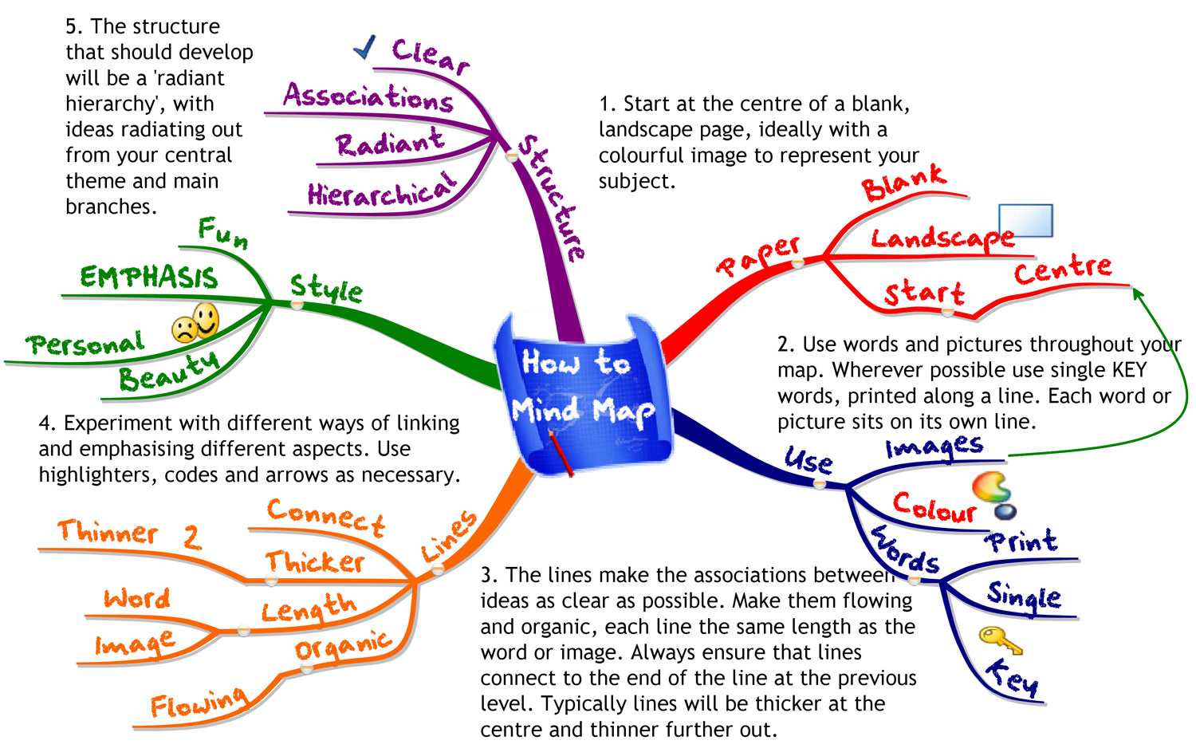
EXAMPLES OF MIND MAP

Slide 16
Mix n Match ( Thomas Edison)
LIST A | LIST B
PERFUME | CIGARETTE
SCOTCH TAPE | INSECT KILLER SPRAY
CHOCOLATE | SOAP
PEN | OLIVES
RUBBER | SHIRT
GLASS (Water wala) | KASHMIRI TEA
PAPER | ASH TRAY
BISCUITS | NAIL POLISH REMOVER
MOUTH FRESHNER | PIZZA
PAD LOCK | ALARM

Slide 17
Mix n Match ( Thomas Edison)
Glass + Ashtray
Paper + Kashmiri Tea
Biscuits + Olives
Padlock + Alarm
Paper + Soap
Pizza + Chocolate
Perfume + Insect Killer Spray
Pen + Insect Killer Spray

Slide 18
Techniques for Improving the Creative Process
Rapid prototyping
Transforming an idea into an actual model that will point out flaws and lead to design improvements.

Slide 19
Attribute Listing Chart
List the attributes of the product, service or strategy you are examining.
Attributes are parts, properties, qualities or design elements of the thing being looked at.
Draw up a table using these attributes as column headings.
Write down as many variations of the attribute as possible within these columns
Now select one entry from each column. Either do this randomly or select interesting combinations

Slide 20
Attribute Listing Chart to
Attributes for a Lamp
Power Supply
Bulb Type
Light Intensity
Size
Style
Finish
Material

Slide 21
Attribute Listing Chart to Create a new Lamp
POWER SUPPLY | BULB Type | Light Intensity | Size | Style | Finish | Material
Main | Halogen | Low | Very Large | Modern | Black | Wood
Solar | Bulb | Medium | Large | Antique | White | Stone
Generator | LED | High | Medium | Roman | Metallic | Plastic
Oil | Colored |  | Small | Industrial | Fabric
LPG |  |  | Hand Held

Slide 22

Lecture Review
Brainstorming
Mind Mapping
Rapid Prototyping
Mix n Match (Thomas Edison Challenge)
Attribute Listing Chart

